Slide 1
apache storm
David Ostrowski

Slide 2
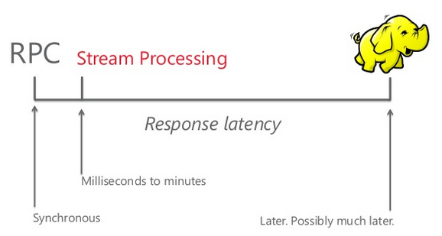
Stream processing

Slide 3
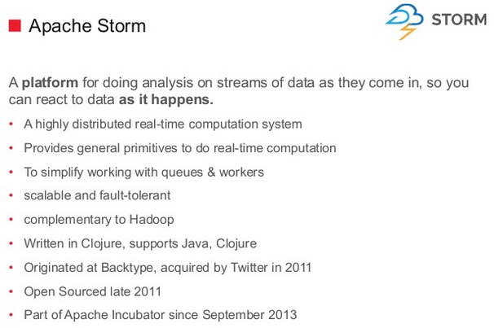

Slide 4
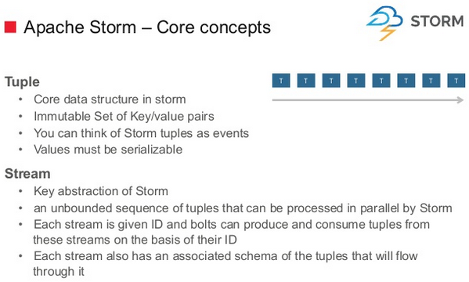

Slide 5
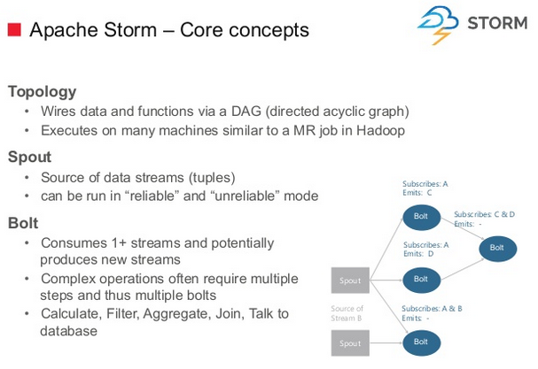

Slide 6
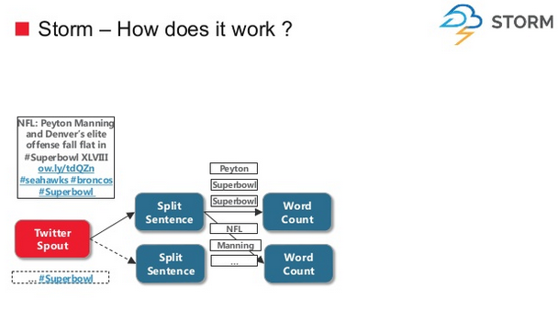

Slide 7
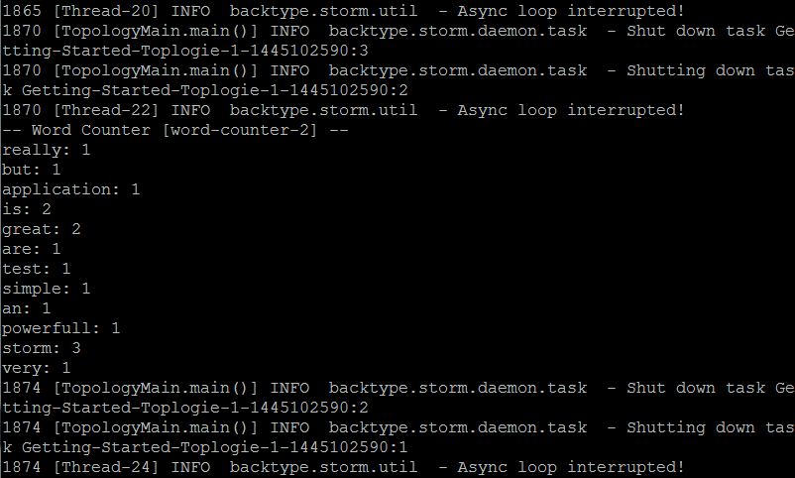
Hello world (O’reilly version)

Slide 8
import spouts.WordReader;
import backtype.storm.Config;
import backtype.storm.LocalCluster;
import backtype.storm.topology.TopologyBuilder;
import backtype.storm.tuple.Fields;
import bolts.WordCounter;
import bolts.WordNormalizer;
public class TopologyMain {
public static void main(String[] args) throws InterruptedException {
//Topology definition
TopologyBuilder builder = new TopologyBuilder();
builder.setSpout("word-reader",new WordReader());
builder.setBolt("word-normalizer", new WordNormalizer())
.shuffleGrouping("word-reader");
builder.setBolt("word-counter", new WordCounter(),1)
.fieldsGrouping("word-normalizer", new Fields("word"));
//Configuration
Config conf = new Config();
conf.put("wordsFile", args[0]);
conf.setDebug(false);
//Topology run
conf.put(Config.TOPOLOGY_MAX_SPOUT_PENDING, 1);
LocalCluster cluster = new LocalCluster();
cluster.submitTopology("Getting-Started-Toplogie", conf, builder.createTopology());
Thread.sleep(1000);
cluster.shutdown();
}
}

Slide 9
Spout.java
package spouts; import java.io.BufferedReader; import java.io.FileNotFoundException; import java.io.FileReader; import java.util.Map; import backtype.storm.spout.SpoutOutputCollector; import backtype.storm.task.TopologyContext; import backtype.storm.topology.OutputFieldsDeclarer; import backtype.storm.topology.base.BaseRichSpout; import backtype.storm.tuple.Fields; import backtype.storm.tuple.Values; public class WordReader extends BaseRichSpout { private SpoutOutputCollector collector; private FileReader fileReader; private boolean completed = false; public void ack(Object msgId) { System.out.println("OK:"+msgId); } public void close() {} public void fail(Object msgId) { System.out.println("FAIL:"+msgId); } /** * The only thing that the methods will do It is emit each * file line */ public void nextTuple() { /** * The nextuple it is called forever, so if we have been readed the file * we will wait and then return */ if(completed){ try { Thread.sleep(1000); } catch (InterruptedException e) { //Do nothing }

Slide 10
Spout (cont.)
return; } String str; //Open the reader BufferedReader reader = new BufferedReader(fileReader); try{ //Read all lines while((str = reader.readLine()) != null){ /** * By each line emmit a new value with the line as a their */ this.collector.emit(new Values(str),str); } }catch(Exception e){ throw new RuntimeException("Error reading tuple",e); }finally{ completed = true; } } /** * We will create the file and get the collector object */ public void open(Map conf, TopologyContext context, SpoutOutputCollector collector) { try { this.fileReader = new FileReader(conf.get("wordsFile").toString()); } catch (FileNotFoundException e) { throw new RuntimeException("Error reading file ["+conf.get("wordFile")+"]"); } this.collector = collector; } /** * Declare the output field "word" */ public void declareOutputFields(OutputFieldsDeclarer declarer) { declarer.declare(new Fields("line")); } }

Slide 11
Bolt.java
package bolts;
import java.util.HashMap;
import java.util.Map;
import backtype.storm.task.TopologyContext;
import backtype.storm.topology.BasicOutputCollector;
import backtype.storm.topology.OutputFieldsDeclarer;
import backtype.storm.topology.base.BaseBasicBolt;
import backtype.storm.tuple.Tuple;
public class WordCounter extends BaseBasicBolt {
Integer id;
String name;
Map<String, Integer> counters;
/**
* At the end of the spout (when the cluster is shutdown
* We will show the word counters
*/
@Override
public void cleanup() {
System.out.println("-- Word Counter ["+name+"-"+id+"] --");
for(Map.Entry<String, Integer> entry : counters.entrySet()){
System.out.println(entry.getKey()+": "+entry.getValue());
}
}
/**
* On create
*/
@Override
public void prepare(Map stormConf, TopologyContext context) {
this.counters = new HashMap<String, Integer>();
this.name = context.getThisComponentId();
this.id = context.getThisTaskId();
}

Slide 12
Bolt (cont.)
@Override
public void declareOutputFields(OutputFieldsDeclarer declarer) {}
@Override
public void execute(Tuple input, BasicOutputCollector collector) {
String str = input.getString(0);
/**
* If the word dosn't exist in the map we will create
* this, if not We will add 1
*/
if(!counters.containsKey(str)){
counters.put(str, 1);
}else{
Integer c = counters.get(str) + 1;
counters.put(str, c);
}
}
}

Slide 13
references
Leibiusky, Jonathan, Gabriel Eisbruch, and Dario Simonassi. Getting started with storm. " O'Reilly Media, Inc.", 2012.
https://github.com/xetorthio/getting-started-with-storm/blob/master/ch02GettingStarted.asc
http://www.thecloudavenue.com/2013/11/InstallingAndConfiguringStormOnUbuntu.html
http://stackoverflow.com/questions/12115160/compiling-jzmq-on-ubuntu

Slide 14
Single node install
1) sudo apt-get install dos2unix
2) copy bash script, env, yaml
3) dos2unix *
3.5) sudo -s
4) chmod 777
5) JAVA_HOME="/usr/lib/jvm/java-1.7.0-openjdk-amd64"
5.5) export JAVA_HOME
6) execute bashscript
6.5) copy *.yaml to apache*/conf
7)start zookeeper server
7.5) set to apache* dir
8) bin/nimbus
9) bin/supervisor
10) bin/ui
11) start the example (see demo page)

Slide 15
demo
wget https://github.com/nathanmarz/storm-starter/archive/master.zip
Unzip master.zip
# cd to the home dir
mvn install
# run it
mvn exec:java -Dexec.mainClass="TopologyMain" -Dexec.args="src/main/resources/words.txt"

